Slide 1

PHILAUTIA
BY YANA MIDHA

Slide 2

ABOUT
PHILAUTIA
We believe that self-love is the foundation of true beauty.
Our mission is to empower you to embrace your natural beauty, enhance your self-confidence, and nurture your skin with the care it deserves.
We are more than just a skincare brand.
We are your partner in the journey towards self-love and
self-care.

Slide 3
“WE WANT YOU TO
FEEL CONFIDENT, COMFORTABLE,
AND YOURSELF .”

Slide 4
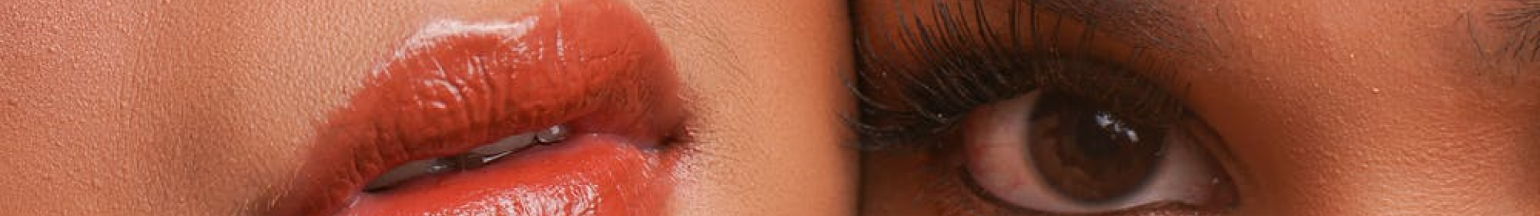
YOUR GATEWAY TO CLEAR SKIN
It's important to use products that suit your skin type and address your specific concerns.
Signup on our Website and get personalized skincare tips.
Healthy skin is not just about appearance.It plays a crucial role in your overall well-being and quality of life.
Healthy skin can boost self-esteem and confidence.

Slide 5
OUR SERVICES:
GUIDE
The content on our is a comprehensive guide to a daily skincare routine
for both daytime and nighttime, covering various essential steps, including
cleansing, toning, treatment, moisturizing, and sun protection. It is informative
and well-structured to provide valuable information to users interested in
maintaining healthy and radiant skin.
SKIN TYPE ANALYSIS
Our website categorizes different skin types and provides information about each and give user personlized tips.

Slide 6
LIP CARE TIPS
Our website provides valuable information about lip care, offering
tips and guidance on keeping lips healthy and well-moisturized. It covers
various aspects of lip care, including hydration, sun protection, the use of lip products, and the importance of cleaning and exfoliation.
TIPS FROM CELEBRITIES
Our website primarily consists of embedded YouTube videos featuring skincare tips from celebrities. The focus is on visual and video-based content.
IMPORTANCE OF HAIR CARE
Our website primarily consists of embedded YouTube videos featuring
skincare tips from celebrities. It does not contain textual content or
descriptions of the videos. The focus is on visual and video-based content.

Slide 7

THANK
YOU

